Slide 1

Budget Way
To Learn

Slide 2
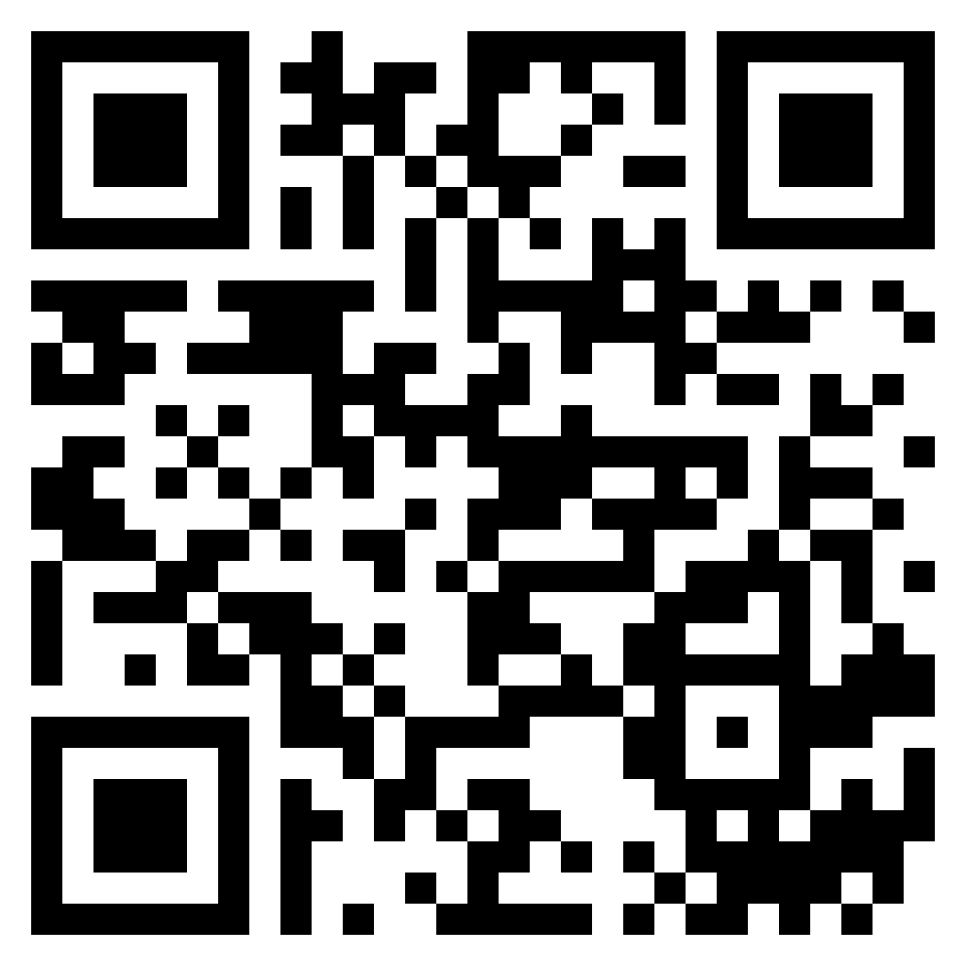
Slido for QNA
https://app.sli.do/event/nMmWrBLMH2JUsQqMFMqhwy/live/polls

Slide 3
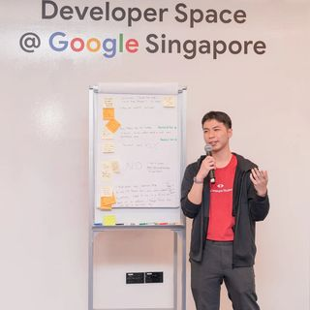


Lai Kai Yong (Vandyck)
Full Stack Software Engineer
GDSC Lead @APU
MLSA
@vandyck.lai
Kai Yong Lai (Vandyck)

Slide 4




Platform
Preference
Notes:
https://www.coursera.org/
Financial Aid
https://www.edx.org/
CS50
https://www.udacity.com/
Apply for Scholarship
https://www.freecodecamp.org/

Slide 5



Learn + Webinar Session
Notes:
https://www.eventbrite.com/d/online/le-wagon/?page=1 https://learn.lewagon.com/
https://www.eventbrite.com/o/thinkful-webinars-17048039731
https://geekle.us/

Slide 6


University-based
Notes:
MIT
https://www.youtube.com/playlist?list=PLtBw6njQRU-rwp5__7C0oIVt26ZgjG9NI
https://openlearning.mit.edu/courses-programs
https://www.youtube.com/results?search_query=MIT+playlist
Harvard
https://pll.harvard.edu/catalog

Slide 7

Google
Cloud Skill Boost
Solution Challenge
Developer Learning Space
Digital Garage
Analytics Academy
(Depreciated soon)
Skillshop
Notes:
https://www.cloudskillsboost.google/

Slide 8

Microsoft
Microsoft Ads
Training Days
Microsoft Learn Cloud Skills Challenge
Microsoft Learn
Imagine Cup
LinkedIn Learning
Free Certification for Student
Notes:
https://learninglab.about.ads.microsoft.com/
https://www.microsoft.com/en-us/trainingdays
https://www.microsoft.com/en-US/cloudskillschallenge/ignite/registration/2022
https://learn.microsoft.com/en-us/training/

Slide 9

IBM
IBM Training Catalog
IBM Skillbuild
Cognitive Class
IBM ZXPlore
Notes:
https://www.ibm.com/training/search

Slide 10

AWS
AWS Event
AWS Skill Builer
AWS Academy
(Inclusive stuff)
AWS Cloud Practitioner Certification Challenge

Slide 11

Github
Student Developer Pack
Github Skill Course
Github Campus Expert: Explore
Notes:
https://education.github.com/pack
https://skills.github.com/

Slide 12

SAS
SAS Course Catalog
SAS Course Dashboard
SAS Hackathon - Curiosity Cup
Notes:
https://support.sas.com/edu/coursesaz.html?&ctry=us
https://www.sas.com/sas/events/hackathon.html
https://auth.sas.com/

Slide 13






Additional Company-based
Notes:
https://www.netacad.com/

Slide 14





Additional Platforms
Notes:
https://www.sololearn.com/
https://www.udemy.com/
https://www.datacamp.com/
https://academy.zenva.com/
https://academy.uipath.com/

Slide 15





More Platforms

Slide 16


Practice makes perfect
* Join Hackathon

Slide 17
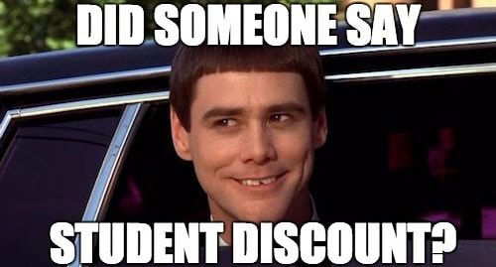
Student
Opportunity

Slide 18



Notes:
https://studentambassadors.microsoft.com/
https://developers.google.com/community/gdsc/leads
https://apply.githubcampus.expert/

Slide 19
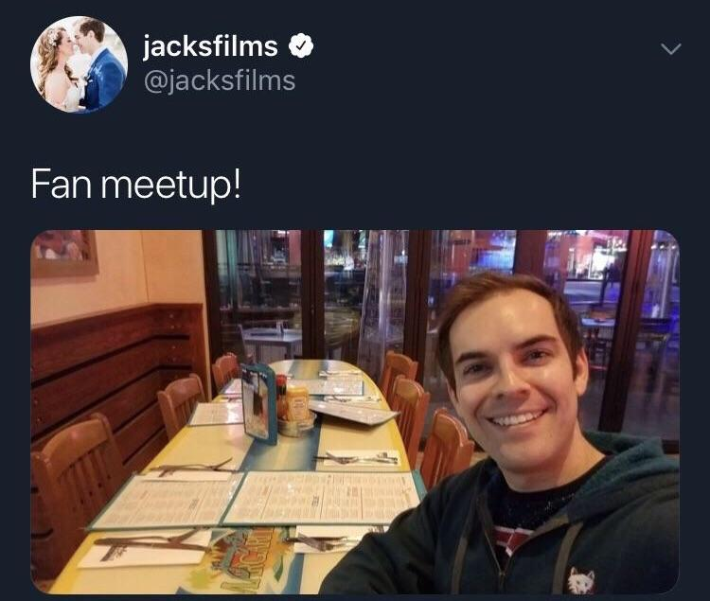
Dev
Meetups

Slide 20


Meetup Organizers
Notes:
https://developerkaki.my/
https://www.facebook.com/groups/developerkaki
https://www.meetup.com/awsugmy/

Slide 21
GDG Georgetown
GDG KL
GDG Cloud KL
Local GDG Organizers
Notes:
https://gdg.community.dev/gdg-george-town/
https://gdg.community.dev/gdg-kuala-lumpur/

Slide 22






APU
Technical
Clubs
Notes:
https://www.instagram.com/apu.apac/
https://www.instagram.com/dsc.apu/
https://www.instagram.com/apubcc/
https://www.instagram.com/apu_fsec.ss/
https://www.instagram.com/ieeeapusb/ https://www.instagram.com/apu_pdh/

Slide 23


Any question just dump here, will try to address all in the end of the event
ⓘ Start presenting to display the poll results on this slide.
Notes:
📣 This is Slido interaction slide, please don't delete it. ✅ Click on 'Present with Slido' and the poll will launch automatically when you get to this slide.

